Slide 1
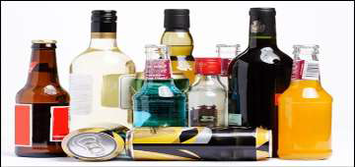
Biotechnology INTRODUCTION AND ITS SCOPE
BY Azhar Javed (Asst. Professor)

Slide 2
Defination
Biotechnology is a combination of biology and technology in which living organisms/systems are used to make products beneficial for mankind.
Now a days biotechnology commonly refers to the use of genetic engineering technology to manipulate the genetic material of organisms and enhance the desired characters.

Slide 3
Branches of Biotechnology
Blue Biotechnology
Red Biotechnology
Green Biotechnology
White Biotechnology

Slide 4
Blue Biotechnology
It deals with marine or aquatic organisms and its relatively a new technology
Marine bioresources are used in Biological applications like molecular biological methods.
Term blue describes water in which these organisms survive.

Slide 5
Red Biotechnology
Refers to the use of organisms for the Improvement of medical processes.
Includes the designing of organisms to manufacture pharmaceutical products like antibiotics and vaccines.
Engineering of genetic cures through genomic manipulation and its use in forensics through DNA profiling.

Slide 6
Green Biotechnology
It is related to agriculture processes like selection, modification and domestication of rare plant species via micropropagation.
Formation of transgenic plants to adopt specific environmental conditions.

Slide 7
White Biotechnology
Also called as industrial biotechnology.
Refers to use of living cells/their enzymes to create industrial products that are more easily degradable, require less energy, create less waste products.
Production of useful chemicals from different organisms.

Slide 8
Biotechnology in genetic transformation
Transformation is genetic alteration of a cell by direct uptake and incorporation of exogenous genetic material.
Suitable Vectors are used as carriers to transport the required genes from donor to recipient cells.
Large number of transgenic plants with agronomically useful genes are produced with this method.

Slide 9
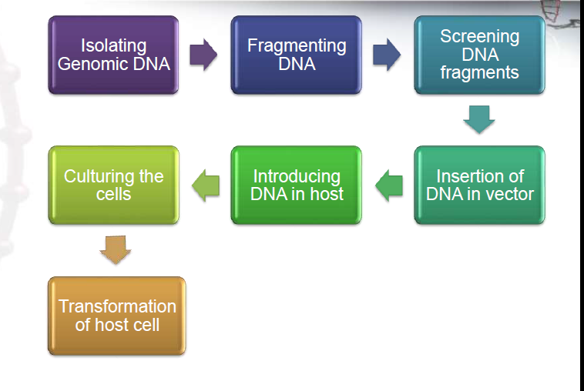
Method of transformation of cell

Slide 10
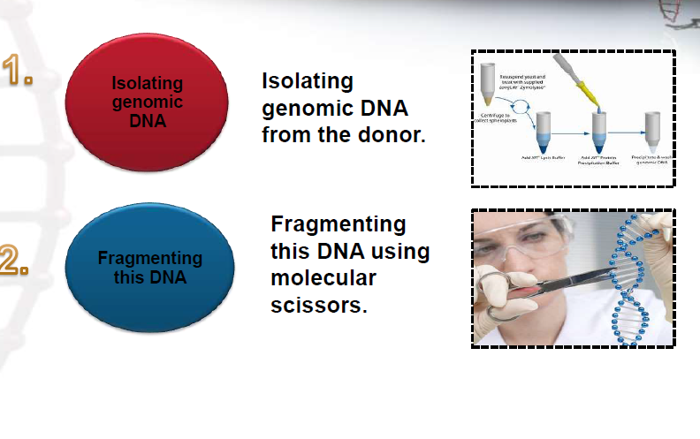
Basic steps involved in transformation

Slide 11
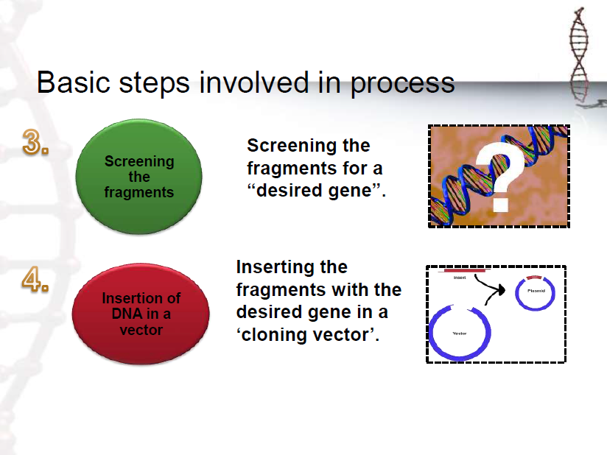

Slide 12
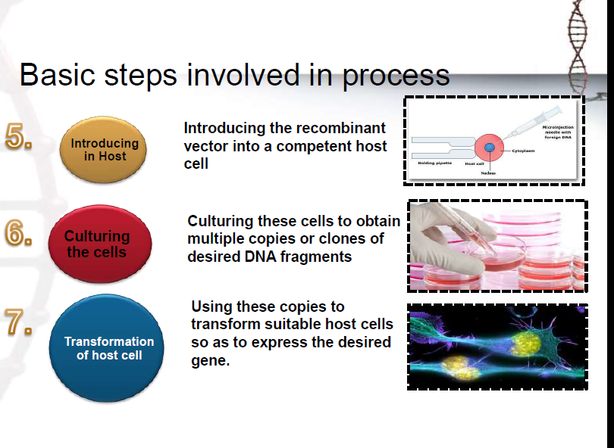

Slide 13
Career in biotechnology
As medical Scientist
Biological/clinical technician
Microbiologist
Scientist
Business development manager
Academician
Biochemist

Slide 14
Pioneers in biotechnology
Antony van leeuwenhoek
1675 born
And discovered bacteria using a simple microscope.
Gregor Mendel
Austrian monk who performed the first genetic experiments using garden pea in mid 1800s.

Slide 15
Louis pasteur
Disapproved the theory of spontaneous generation.
Described the basic process of fermentation.
Created rabbies vaccine.
Robert hooke
Born in 1665
Invented the compound light microscope.
First to see cells under compound microscope.

Slide 16
Scope of Biotechnology in India
India is soon going to be hotspot for biotech industry.
Biotech sector in India is estimated to grow by 30.46 percent by 2025.
India is among the top 12 biotech destinations in the world and third in Asia-pacific region.
Pharmaceutical, Biological sciences, healthcare, food processing industry are blooming career options in biotechnology.

Slide 17
Thanks

